Slide 1


SMART INDIA HACKATHON 2024
Problem Statement ID – SH-1627
Problem Statement Title-
“Drug Inventory and supply chain Tracking system”
Theme- MedTech/ BioTech / HealthTech
PS Category- Software
Team ID-
Team Name- Coding Crabs

Slide 2
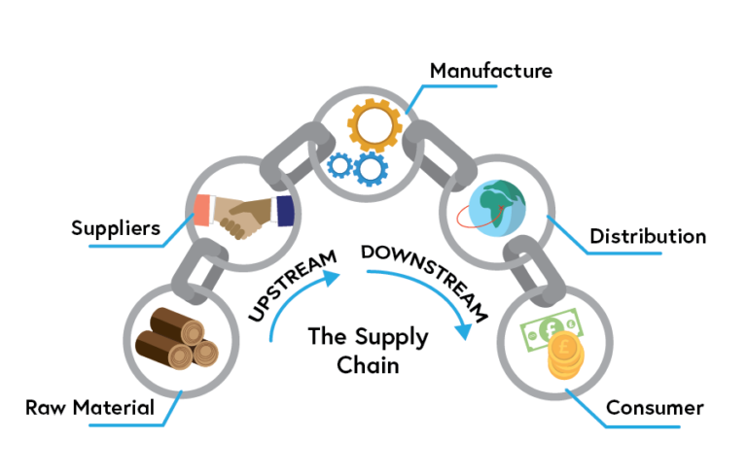
IDEA TITLE
Proposed Solution
The combination of Blockchain and AI creates a secure, transparent, and efficient pharmaceutical supply chain. It ensures drugs are genuine, gives customers confidence in their purchases, and protects public health.
Provide role-specific dashboards to streamline operations.
Use AI algorithms to predict demand based on historical data ,to optimize delivery routes
Monitor deliveries to ensure drugs reach the designated location,
Triggering alerts if the delivery deviates from the planned route.
Implement a scheduling system that prioritizes deliveries based on urgency
Ensures on-time delivery notifications.
Record quality checks at every stage of the supply chain
A centralized dashboard showing real-time data on all levels
Automatic reordering based on consumption data

Slide 3
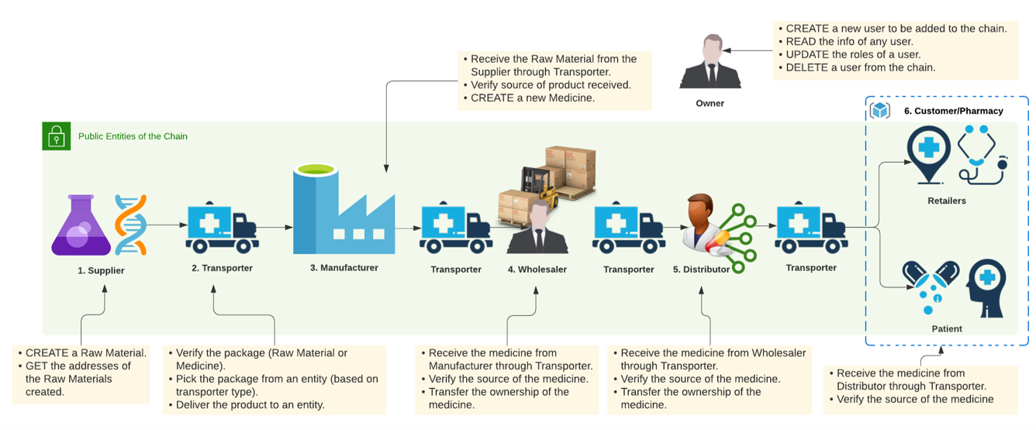
Working Flow
@SIH Idea submission- Template
3

Slide 4
TECHNICAL APPROACH
Blockchain Platform: Ethereum
Smart Contracts: Solidity
Development Framework: Truffle
Local Blockchain Simulator: Ganache
Blockchain Integration Library: Web3.js
Frontend Framework: ReactJS
AI Chatbot Framework: Rasa
Mobile Application Framework: Flutter
Database Management: MongoDB and Firebase Cloud Firestore
Deployment Environment: Node.js

Slide 5
FEASIBILITY AND VIABILITY
Feasibility Analysis of the Idea
1. Technical Feasibility
-->Data Integration
-->User Interface and Experience
2.Operational Feasibility
-->Supply Chain Complexity
-->Resource Availability
3.Economic Feasibility
-->Cost of Development and Implementation
-->Long-Term Cost Savings
-->Funding Sources
Potential Challenges and Risks
1.Data Privacy and Security
2.Integration with Existing Systems
3.To check Quantity and its condition,either a person or a Iot device
is required.
4.Supply Chain Disruptions
Strategies for Overcoming These Challenges:
1.Implement Advanced Security Measures and Ensure Regulatory Compliance.
2.Regular Monitoring and Adaptation and Engage with Regulatory Bodies.
3.Diversify Supply Chains and Implement Predictive Analytics.

Slide 6
IMPACT AND BENEFITS
Potential Impact on the Target Audience:-
Healthcare Providers (Hospitals, Clinics, Pharmacies)
-- Enhanced Efficiency
-- Accurate Inventory Control
Patients:
-- Improved Patient Safety
-- Better Access to Medications
Pharmaceutical Companies
-- Optimized Production Planning
-- Reduced Counterfeiting
Benefits of the Solution:
Social Benefits:
-- Increased Public Health Outcomes
-- Equity in Drug Distribution
Economic Benefits:
-- Cost Savings
-- Economic Growth
Environmental Benefits
-- Reduced Waste
-- Sustainable Practices

Slide 7
RESEARCH AND REFERENCES
1."Blockchain Applications in the Pharmaceutical Supply Chain" by A. K. Dasaklis, F. Casino, and G. Patsakis. This paper discusses how blockchain can enhance transparency and traceability in drug supply chains.
2.“Pharmaceutical Supply Chain Risk Management: An Integrated Approach” by T. P. Harrison and H. Lee. This paper presents a framework for managing risks across the pharmaceutical supply chain, with a focus on supply chain visibility and flexibility.
3.web3.js - Ethereum JavaScript API. Accessed: Aug. 28, 2020. [Online]. Available: https://web3js.readthedocs.io/en/1.0/
4.Truffle. Accessed: Aug. 28, 2020. [Online]. Available: https://www.trufflesuite.com/truffle
5.Leng, Kaijun, Y. Bi, Linbo Jing, Han-Chi Fu and I. Nieuwenhuyse. “Research on agricultural supply chain system with double chain architecture based on blockchain technology.” Future Gener. Comput. Syst. 86 (2018): 641-649.

